Slide 1




Capstone Project Report On
TRAVEL APPROVAL APP
BY:
Name: Kadiyam Venkata Swamy
Batch WIP-SF-13
LMS Id: MGSA_521

Slide 2

CONTENTS:
INTRODUCTION OF TRAVEL APPROVAL APP
MODULE 1
MODULE 2
MODULE 3
CONCLUSION

Slide 3
INTRODUCTION OF TRAVEL APPROVAL APP:
The travel approval project in Salesforce is a system designed to automate and streamline the process of requesting and approving travel expenses for employees. The project involves several components, including a custom object to track travel requests, a custom approval process, and various integrations with external systems.
Overall, the travel approval project in Salesforce provides a streamlined and efficient way for employees to request and manage travel expenses, while also providing managers with the tools they need to ensure that all expenses are approved and accounted for.

Slide 4
MODULE 1:
This project module focuses on the non-coding approach to modifying
the user interface, as you customize an app that tracks company travel.
Create Custom
App, Objects, Fields & Relationships, and how you customize the App using declarative tools.
Module Take Away

Slide 5
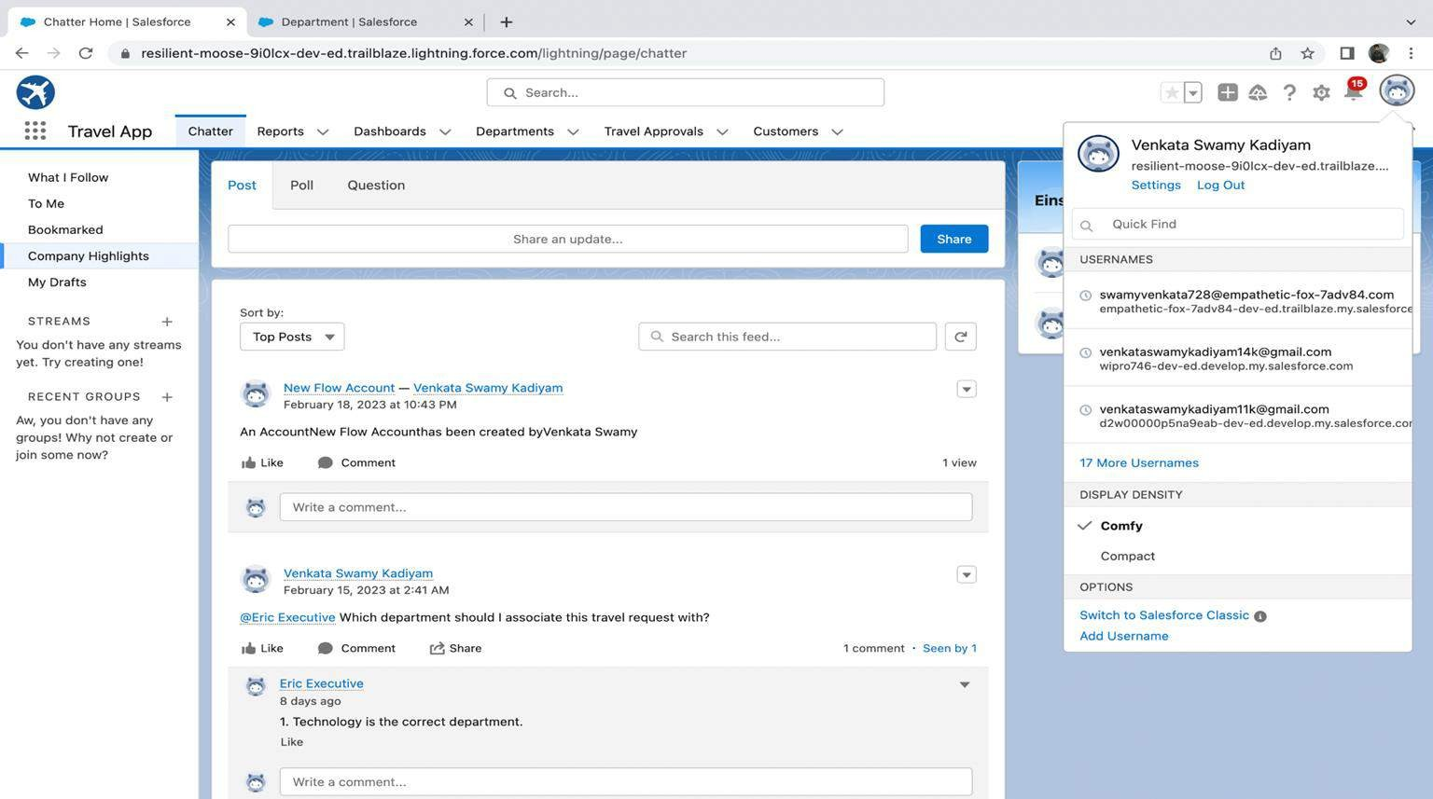
CREATING LIGHTNING APP: TRAVEL APP

Slide 6
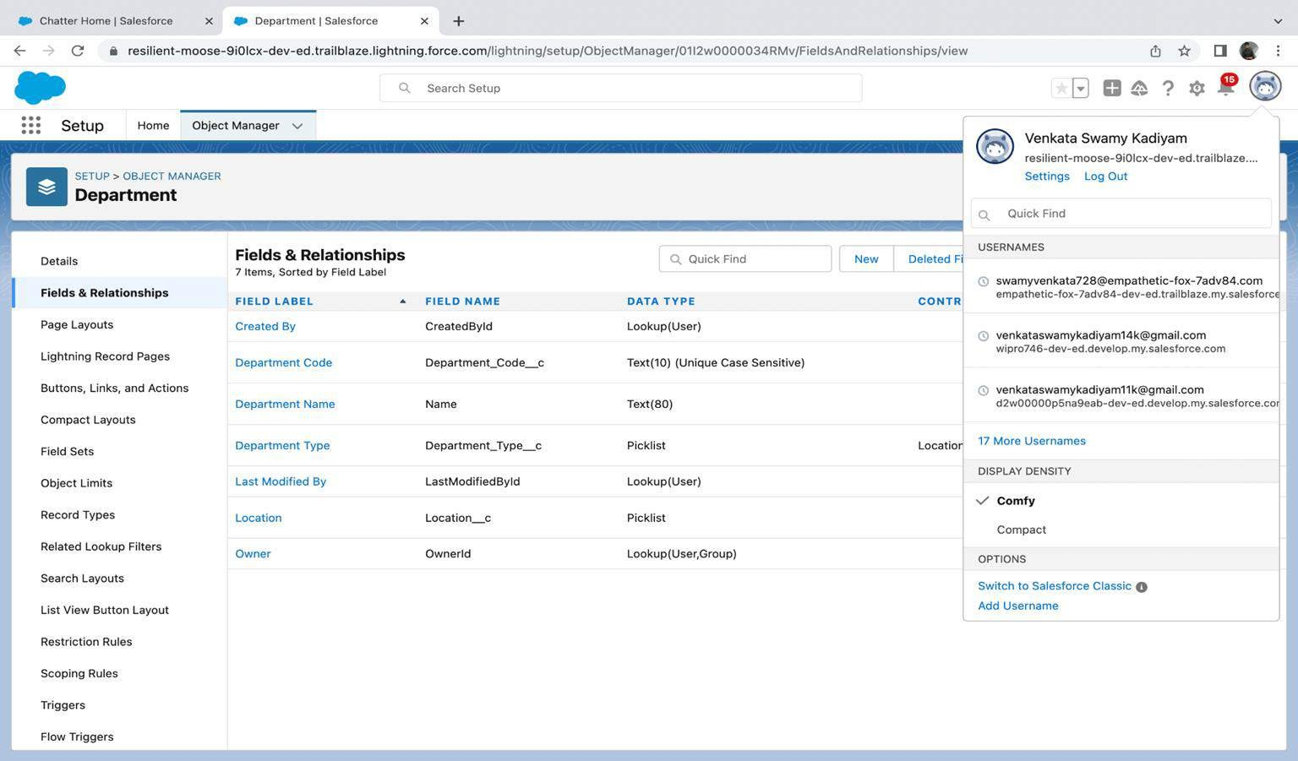
CUSTOM OBJECT DEPARTMENT AND CREATING CUSTOM FIELDS
IN DEPARTMENT OBJECT:

Slide 7
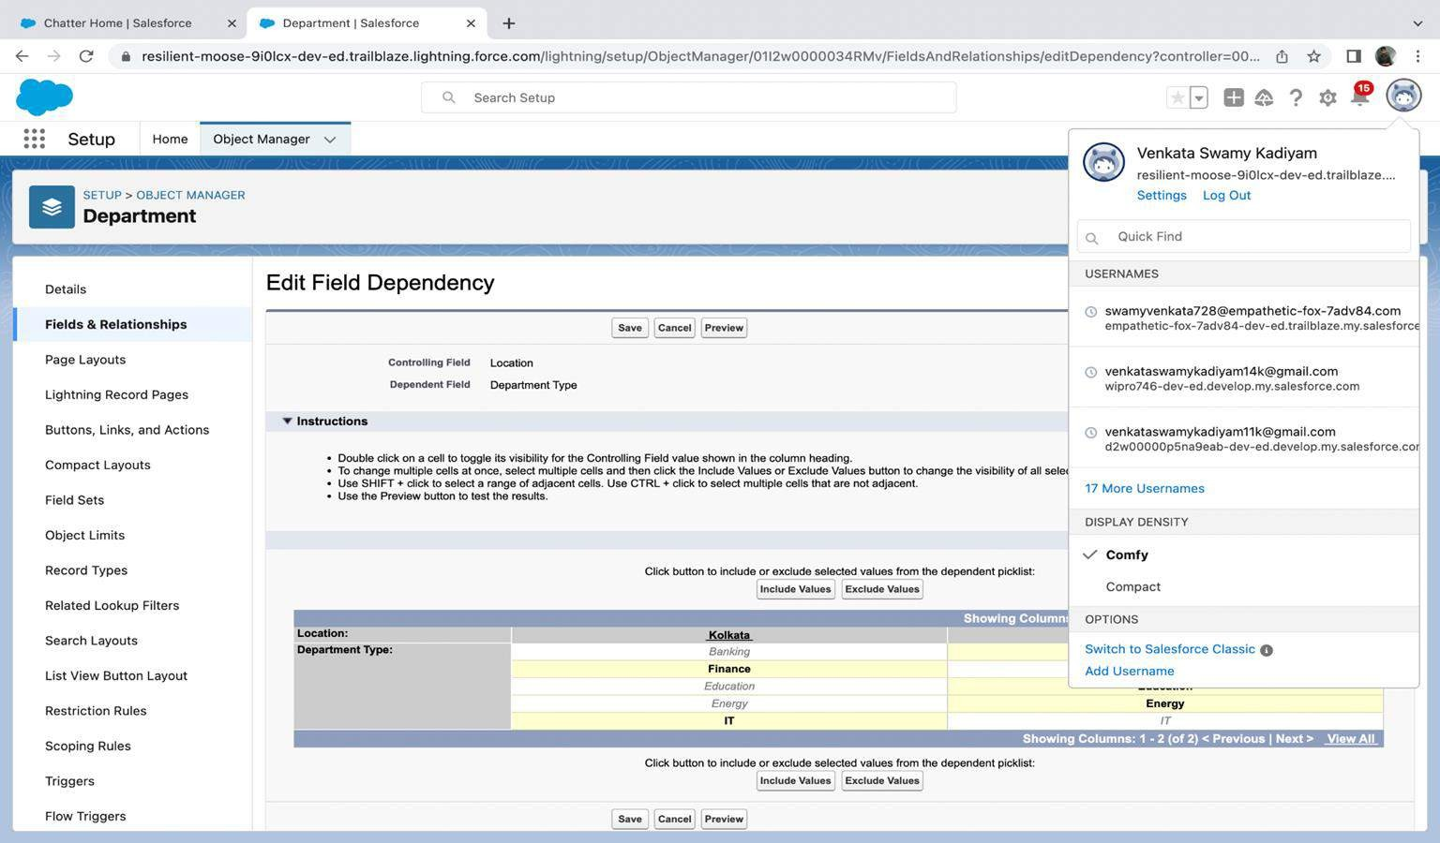
FIELD DEPENDENCY IN DEPARTMENT:

Slide 8
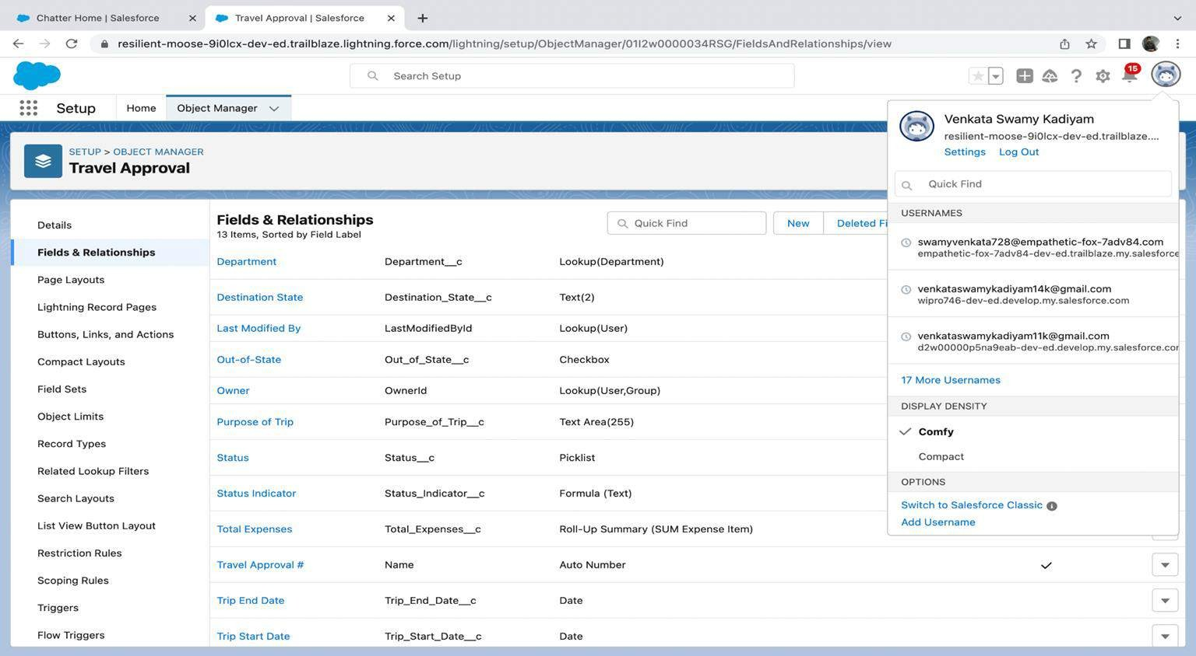
CREATING CUSTOM OBJECT TRAVEL APPROVAL AND CUSTOM FIELDS IN THAT OBJECT:

Slide 9
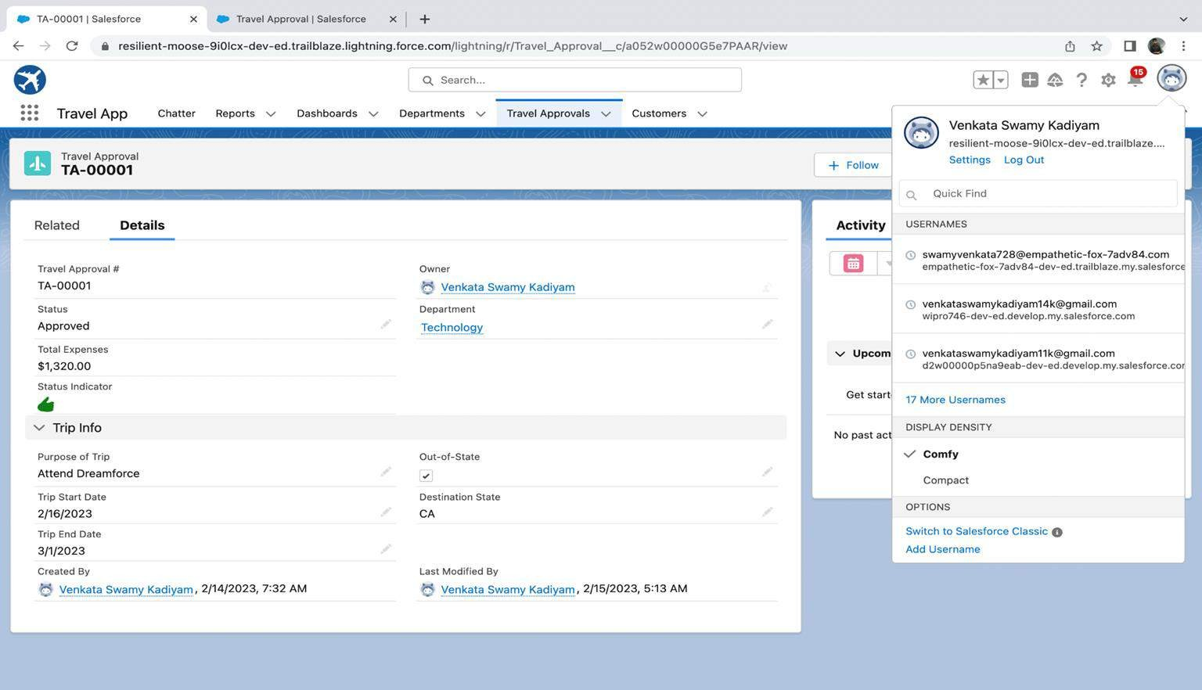
AFTER CREATING TRAVEL APPROVAL OBJECT WITH FIELDS, IT LOOKS AS SHOWN BELOW:

Slide 10
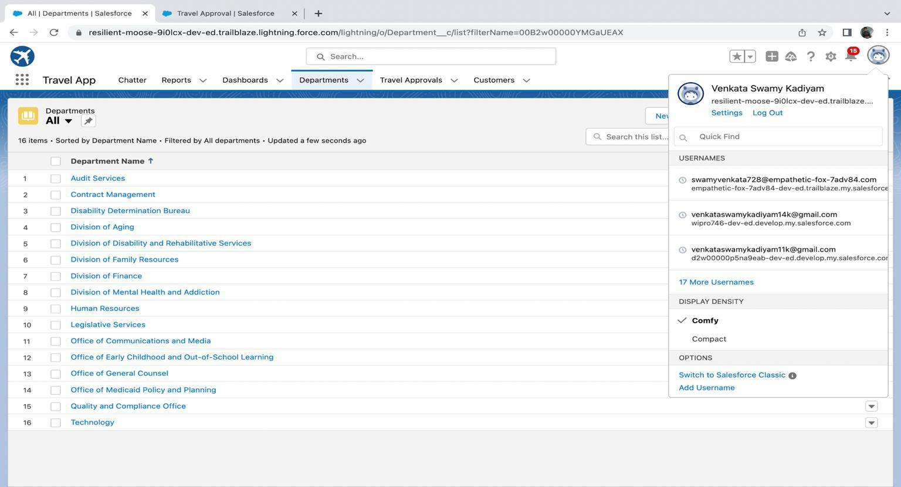
IMPORTING DEPARTMENT RECORDS USING DATA IMPORT WIZARD AND
IMPORTED RECORD DATA STATUS CAN VIEWED BELOW:

Slide 11
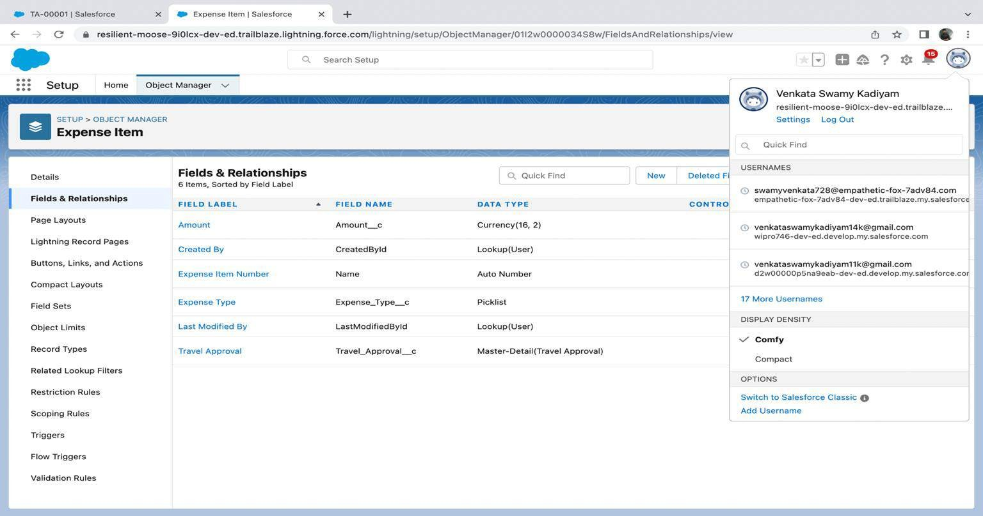
CREATING EXPENSE ITEM CUSTOM OBJECT AND CUSTOM FIELDS
IN EXPENSE ITEM OBJECT:

Slide 12
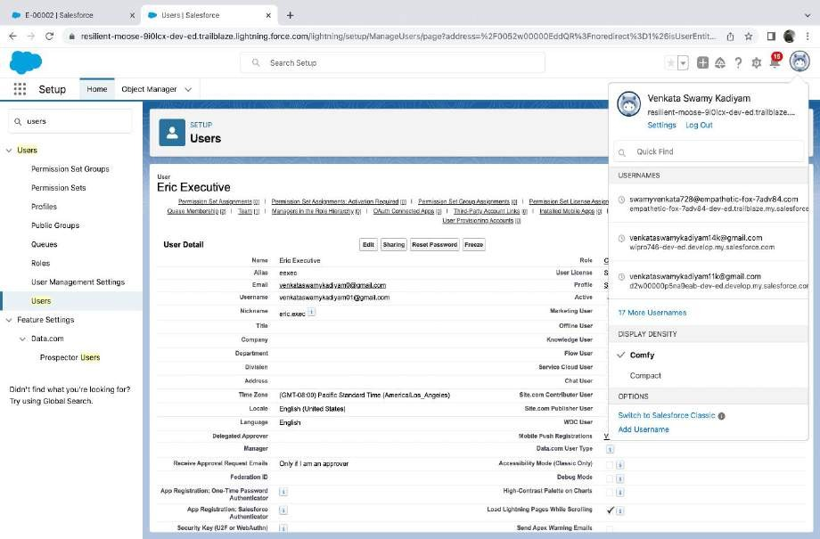
Creating User with system admin license
Add user eric as
manager own account user

Slide 13
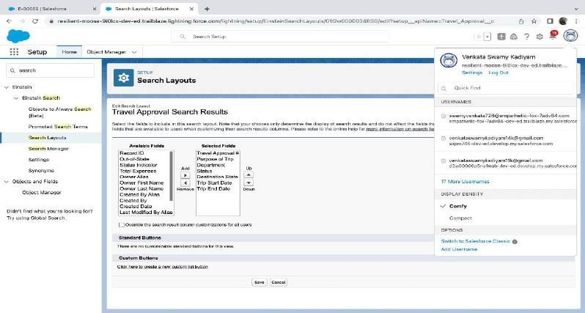
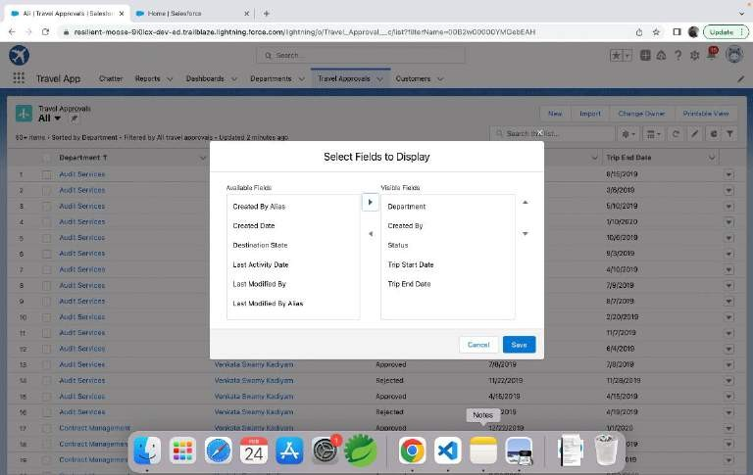
Customize the Travel Approval Default search layout
Select fields to display in the Travel
Approval “All” List view

Slide 14
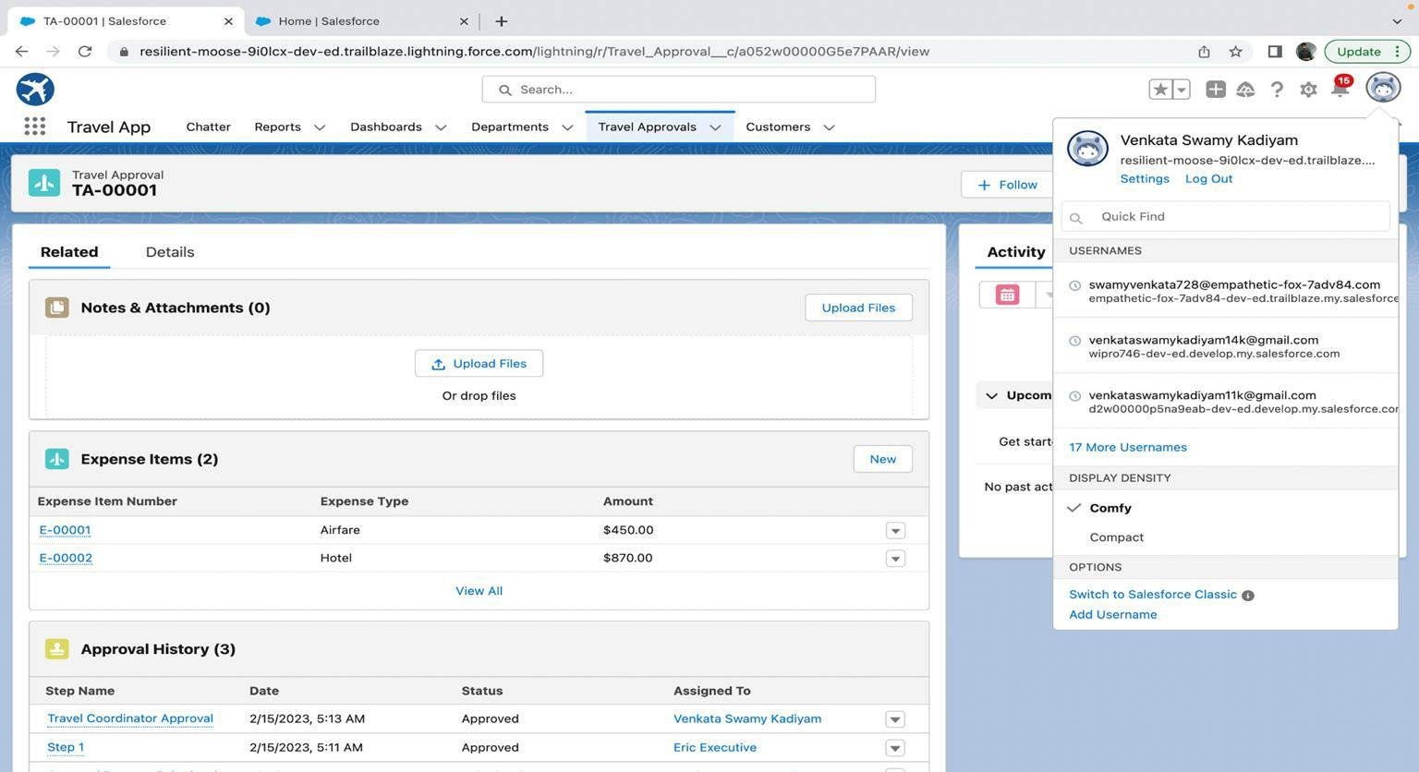
CUSTOMIZING PAGE LAYOUT:

Slide 15
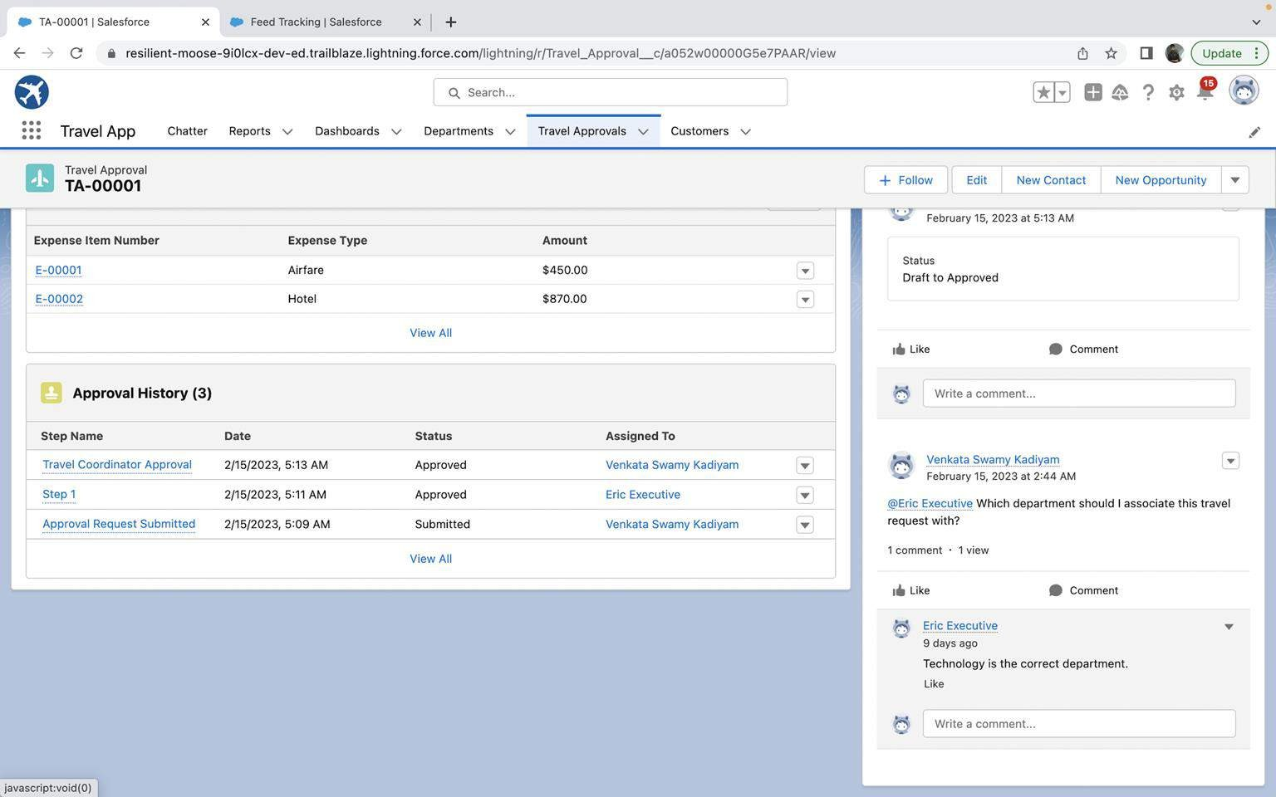
TEST THE APP:

Slide 16

MODULE 2:
This project module focuses on the Automation and Analytics Tools to enhance your custom App development.
Define Business logic using Validation rules, Roll-up summary fields, Formulas, Flows & how you track Travel Approvals using Reports and Dashboards
Module Take Away

Slide 17
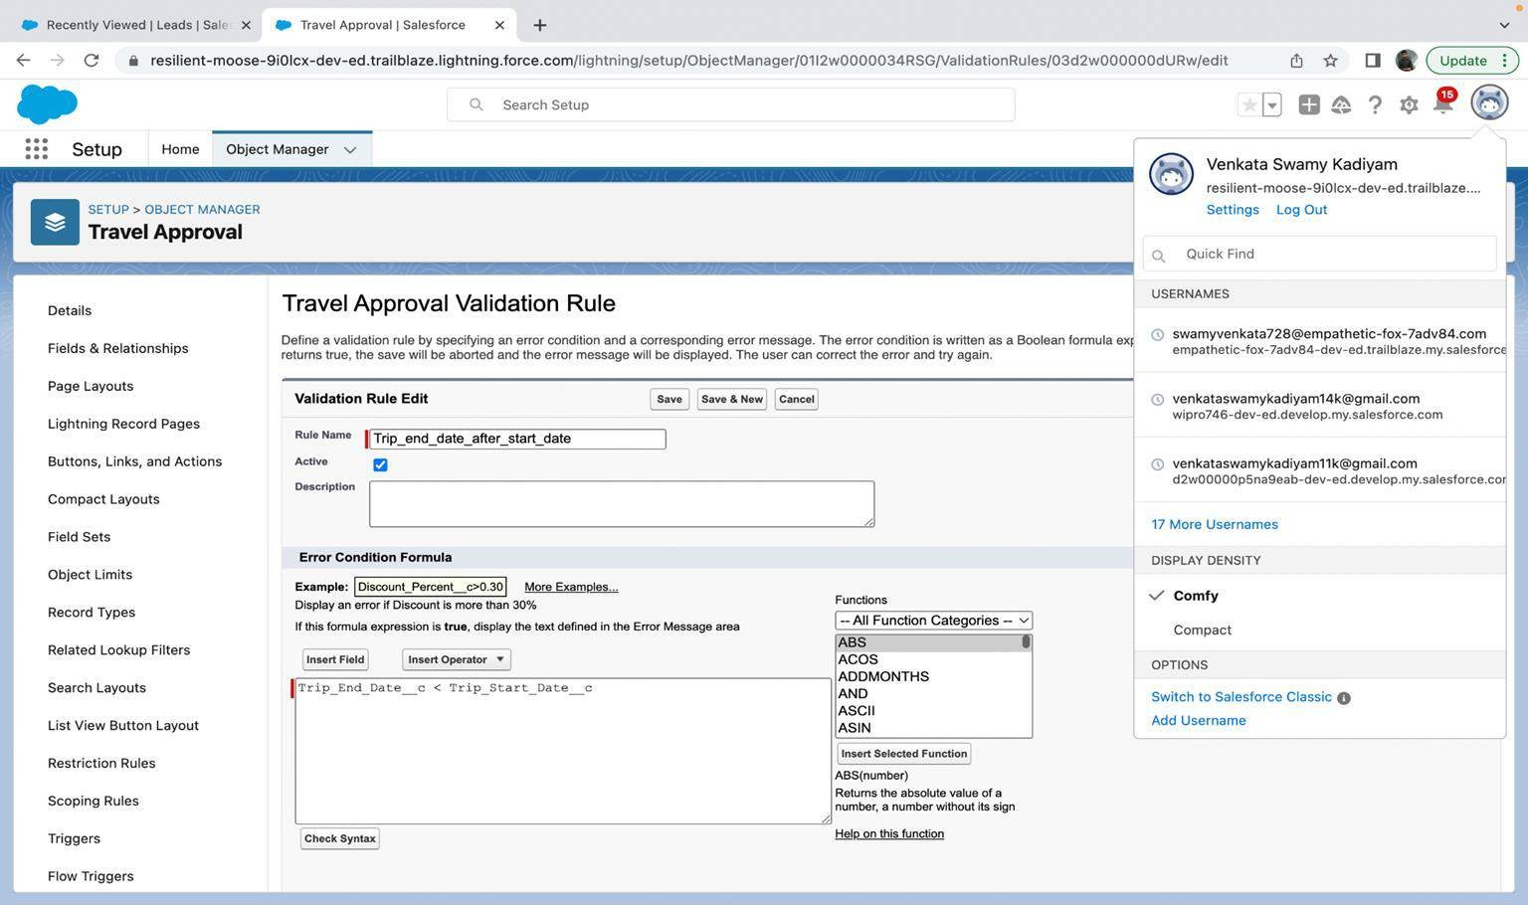
VALIDATION RULE THAT TRIP END DATE ALWAYS >= START
DATE

Slide 18
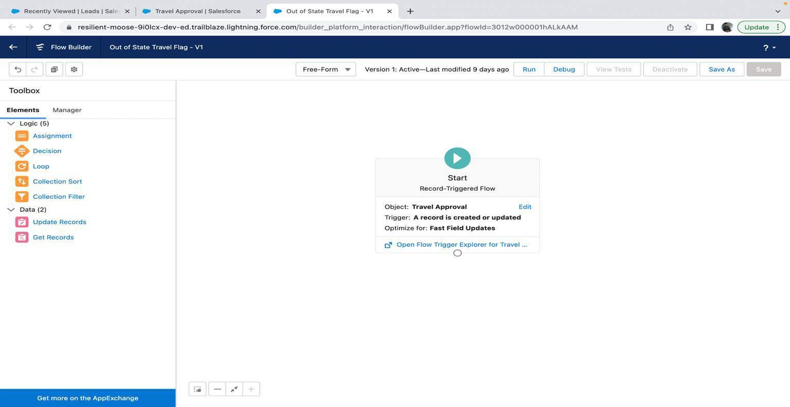
CREATE A RECORD – TRIGGERED FLOW:

Slide 19
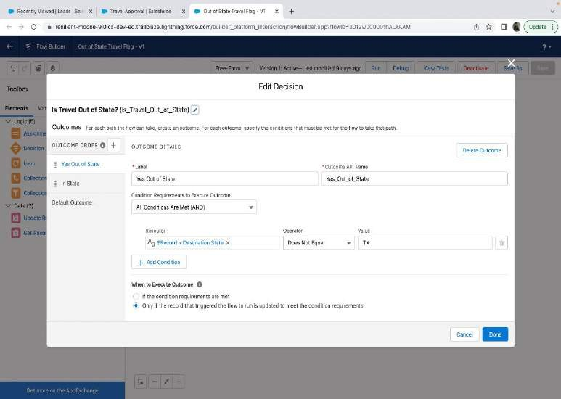
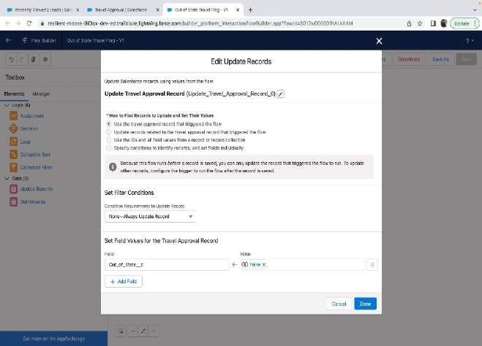
AND ADD DECISION ELEMENT TO FLOW:

Slide 20
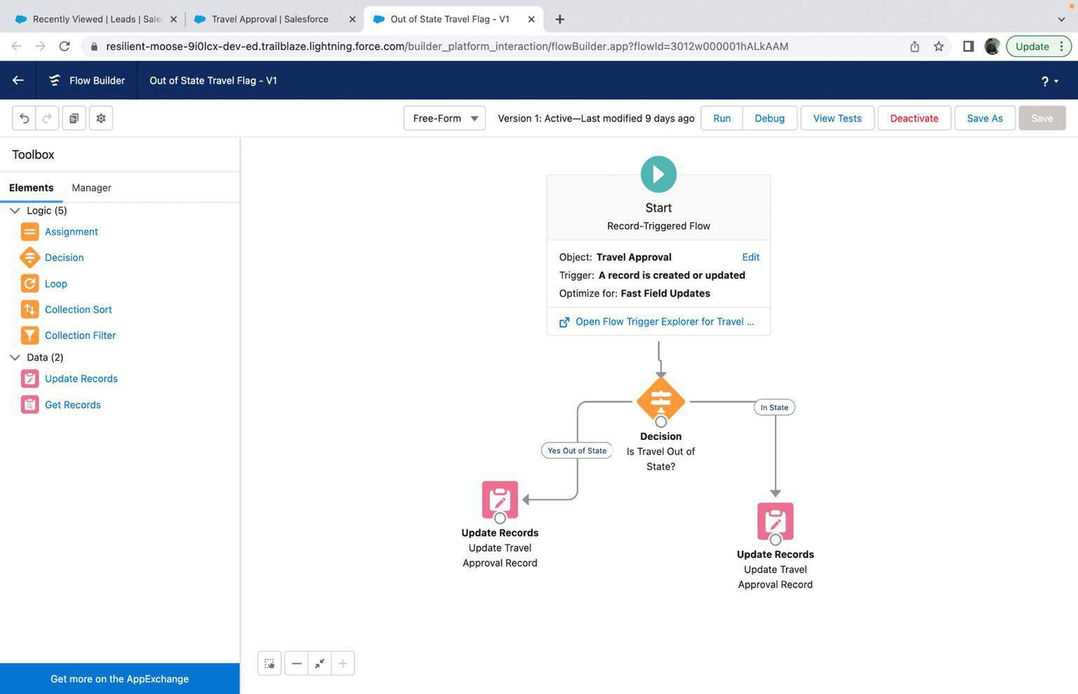
FINALLY, THE FLOW LOOKS AS SHOWN, SAVE AND ACTIVATE:

Slide 21
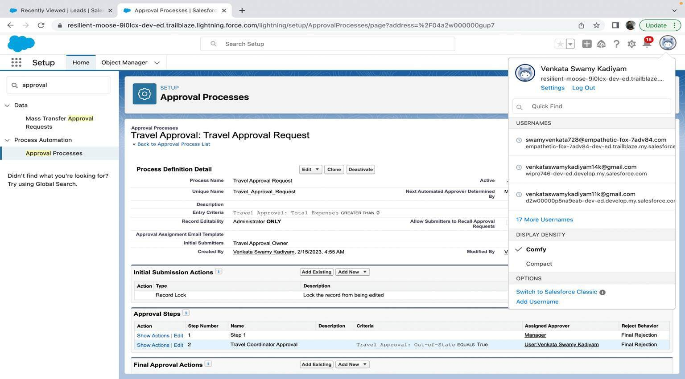
CREATING AN APPROVAL PROCESS TO SEND TRAVEL APPROVALS TO MANAGER OR TRAVEL COORDINATOR:

Slide 22
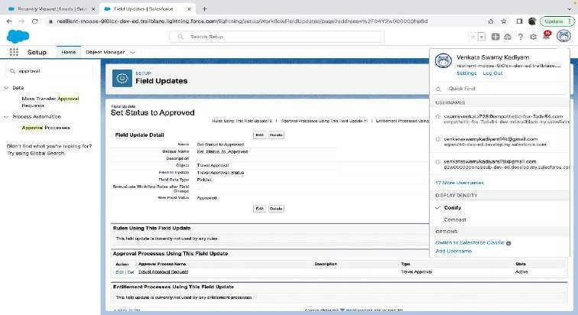

Final Approval Action:
Final Rejection Action:

Slide 23
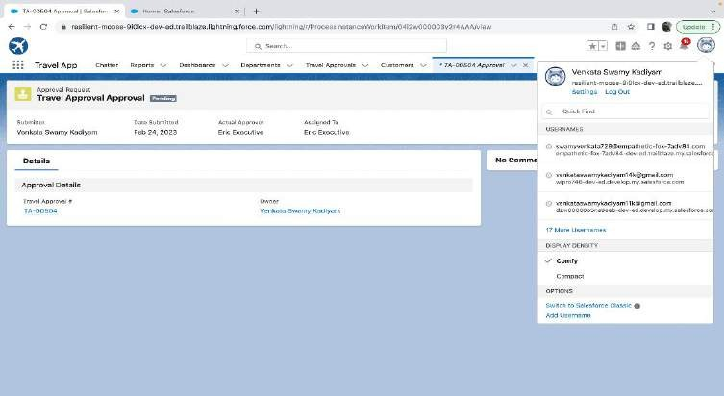
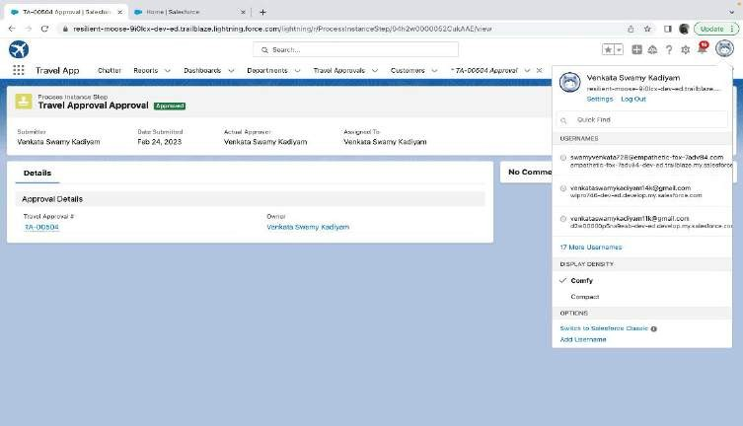
Testing the approval process Status is pending here, Next submit for approval
Eric to give Approval Can Approve or Reject

Slide 24
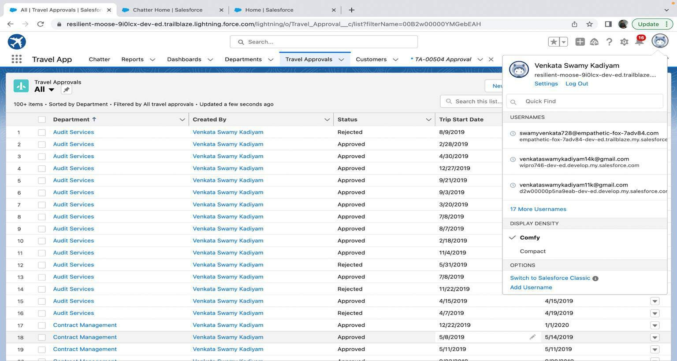
USING DATA IMPORT WIZARD TO IMPORT TRAVEL APPROVAL RECORDS ,
LATER THE RECORDS IMPORTED SUCCESSFULLY:

Slide 25
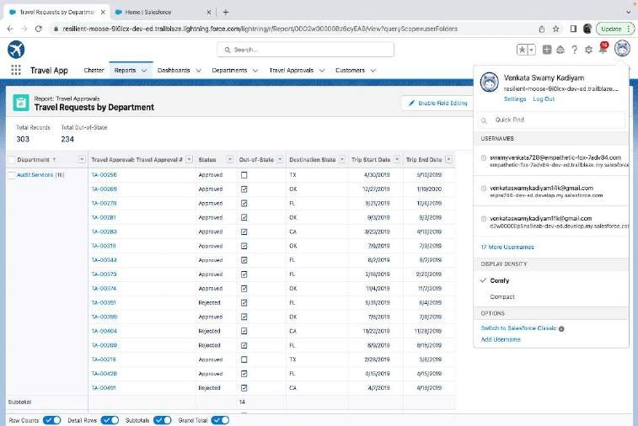
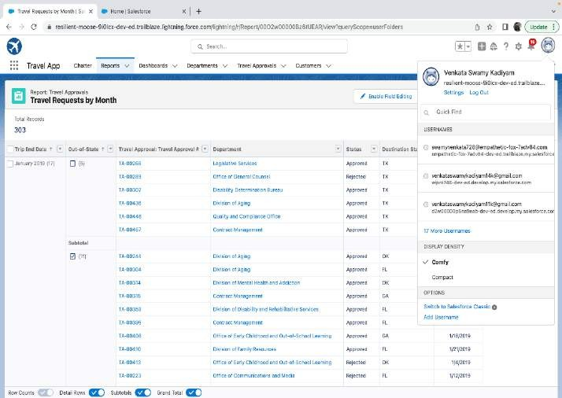
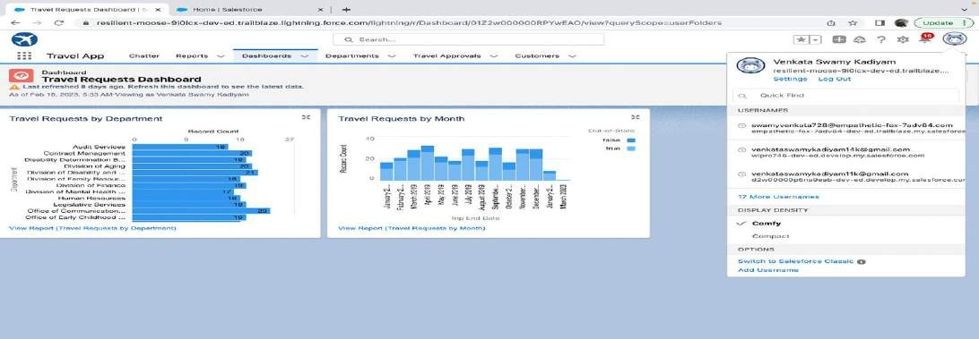
FINAL REPORTS & DASHBOARD:

Slide 26

MODULE 3:
This project module focuses on the coding approach to extend the functional capabilities of your custom App.

Slide 27
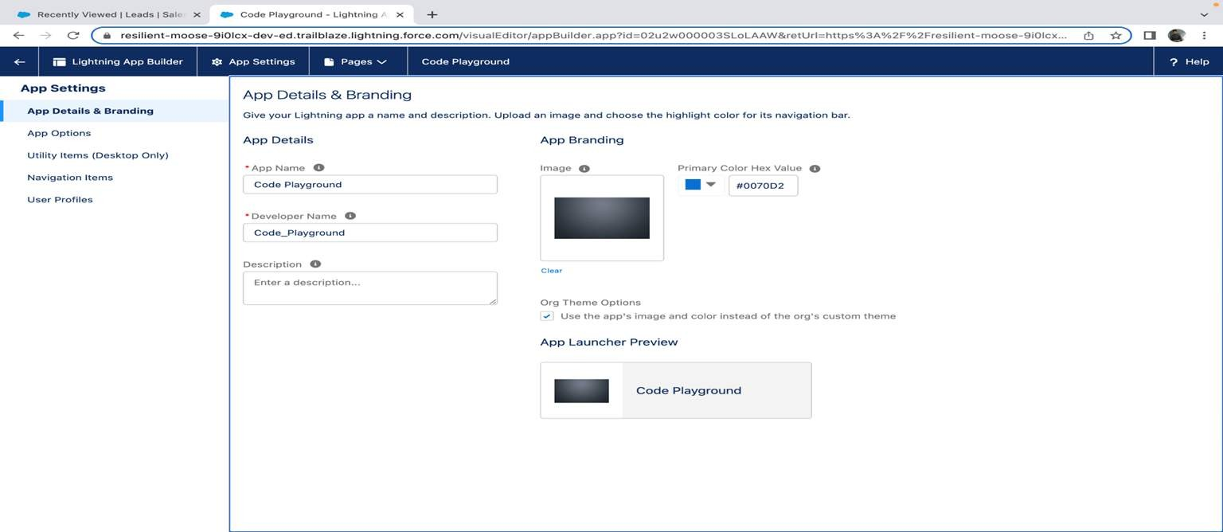
EXERCISE – 01:
CREATING CODE PLAYGROUND LIGHTNING APP WITH LEAD, ACCOUNT, CONTACT, OPPORTUNITY, CASE TO NAVIGATION PROFILE AS SYSTEM ADMIN.

Slide 28
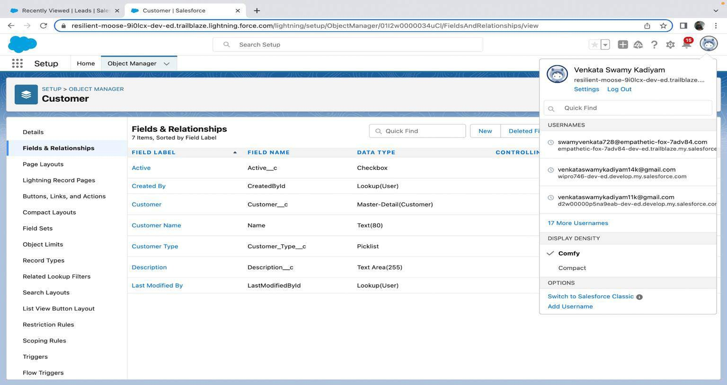
CREATING CUSTOM OBJECT CUSTOMER AND ADD RELATED
FIELDS:

Slide 29
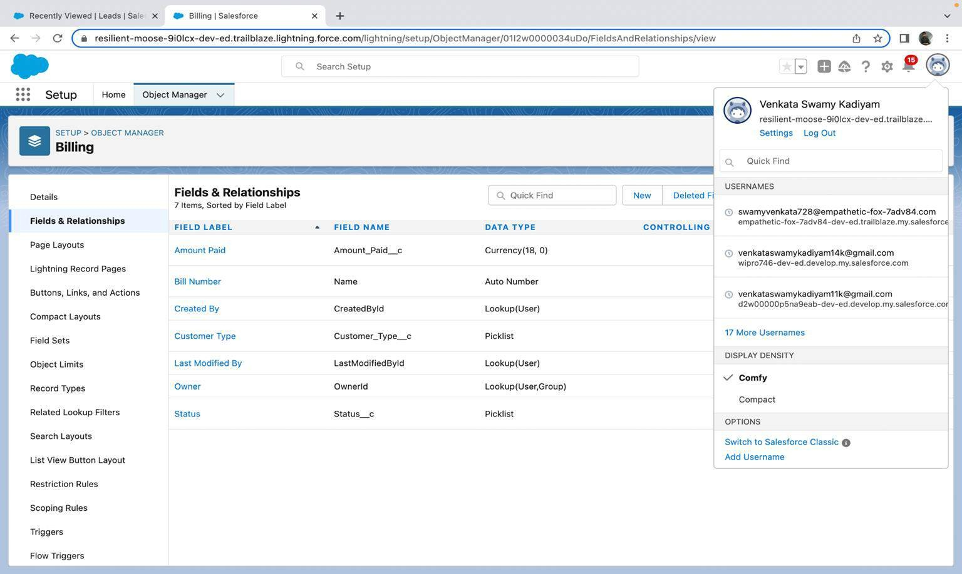
CREATING CUSTOM OBJECT BILLING AND ADD RELATED FIELDS:

Slide 30
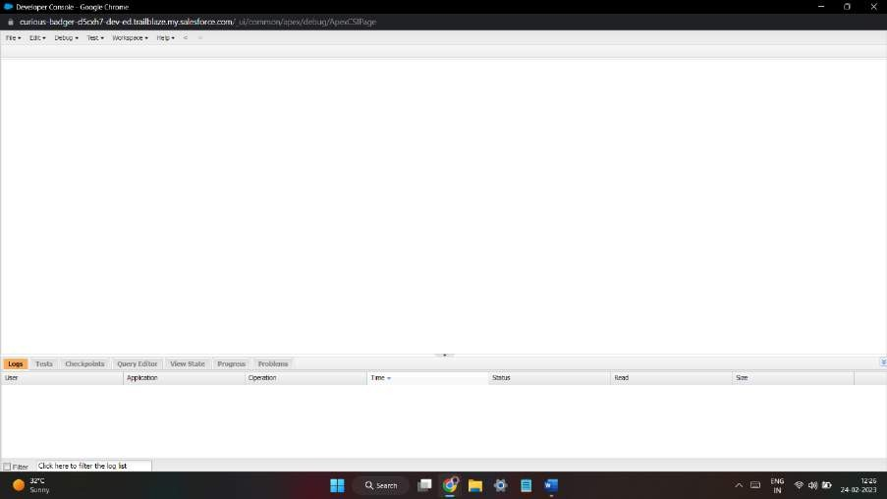
EXERCISE – 02:
USE EXECUTE ANONYMOUS TO DEFINE AND EXECUTE THE FOLLOWING CODE:
DEVELOPER CONSOLE

Slide 31
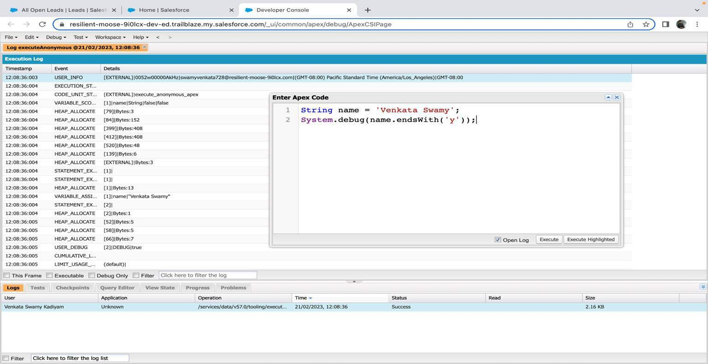
1.DEFINE A STRING VARIABLE & USE STRING METHOD ‘ENDSWITH’ TO
DISPLAY THE OUTPUT.

Slide 32
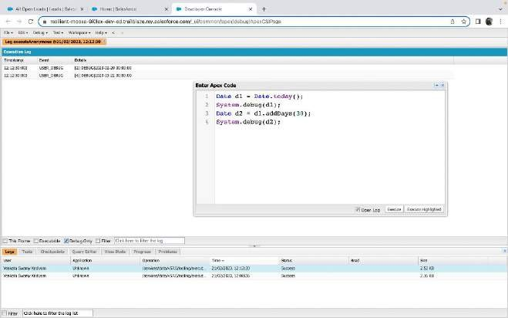
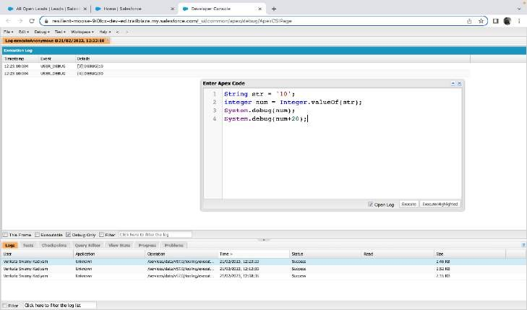
2. Define 2 Date type variables, use Date method today() & add Days(30) to display the output
3. Display the output of an Integer variable from string ‘10’ and then add 20 to it.

Slide 33
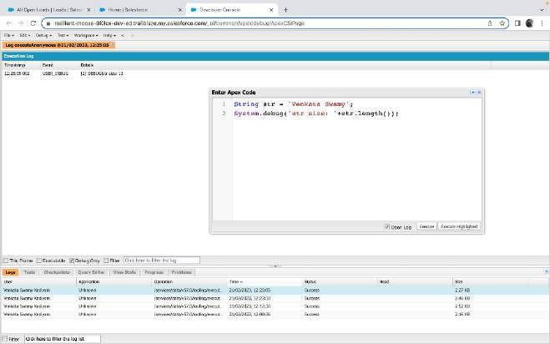
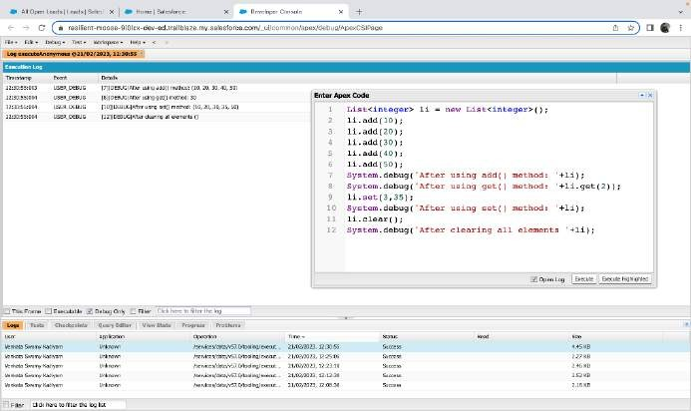
4. Define a String Variable & use string method length() to display the output
5. Define a List of integer and display the output using add(), get(), set(), clear(), methods.

Slide 34
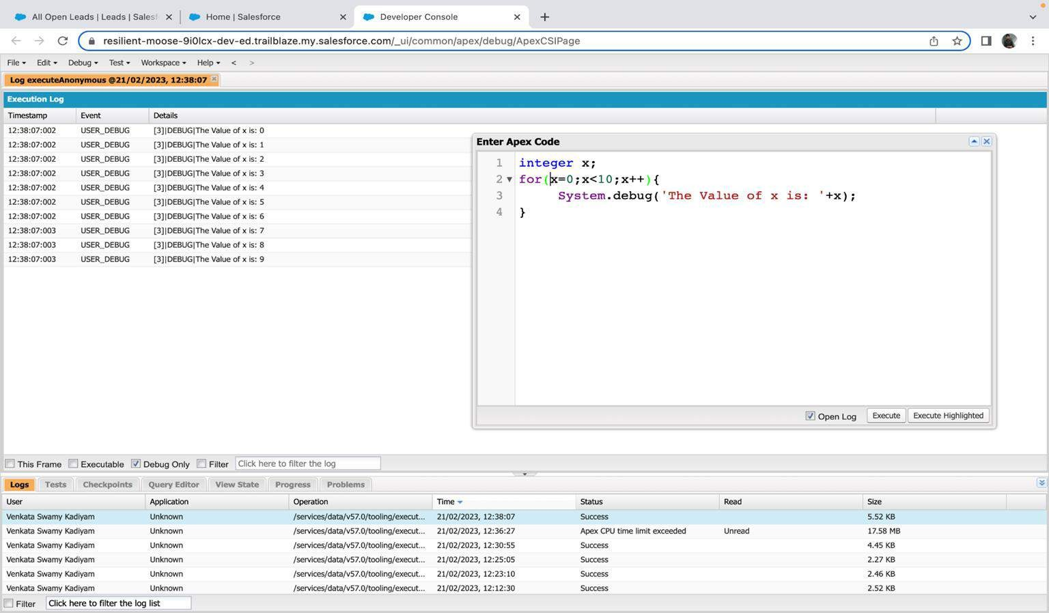
Use Execute Anonymous to define and execute the following code to display the value of x = 0 to 9.

Slide 35
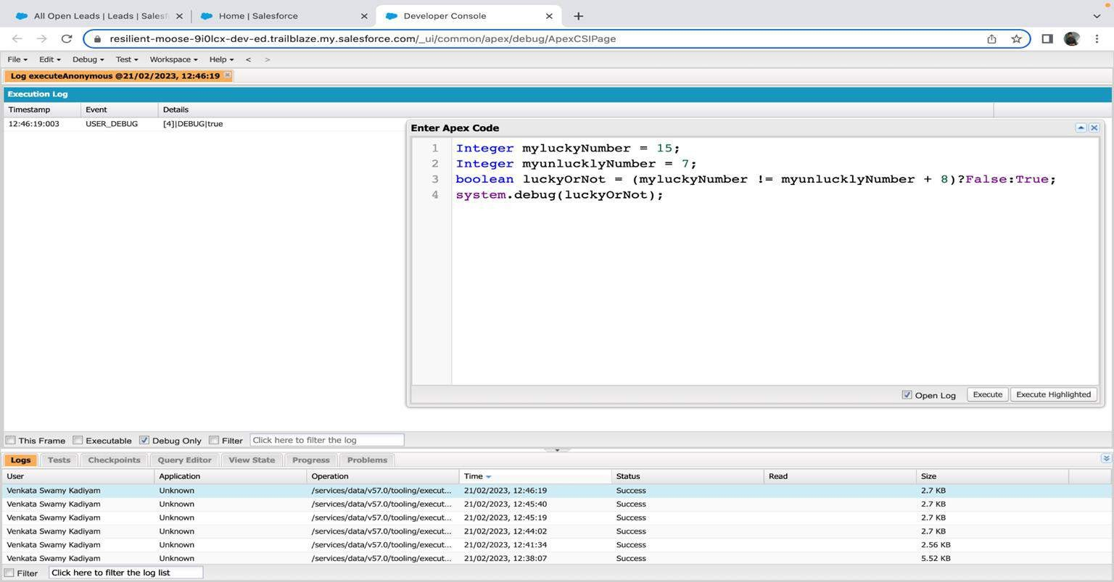
EXERCISE 3:
ANSWER THE FOLLOWING IN TRUE OR FALSE:
INTEGER MYUNLUCKLYNUMBER = 7; INTEGER MYLUCKYNUMBER = 15; MYLUCKYNUMBER != MYUNLUCKLYNUMBER + 8.

Slide 36
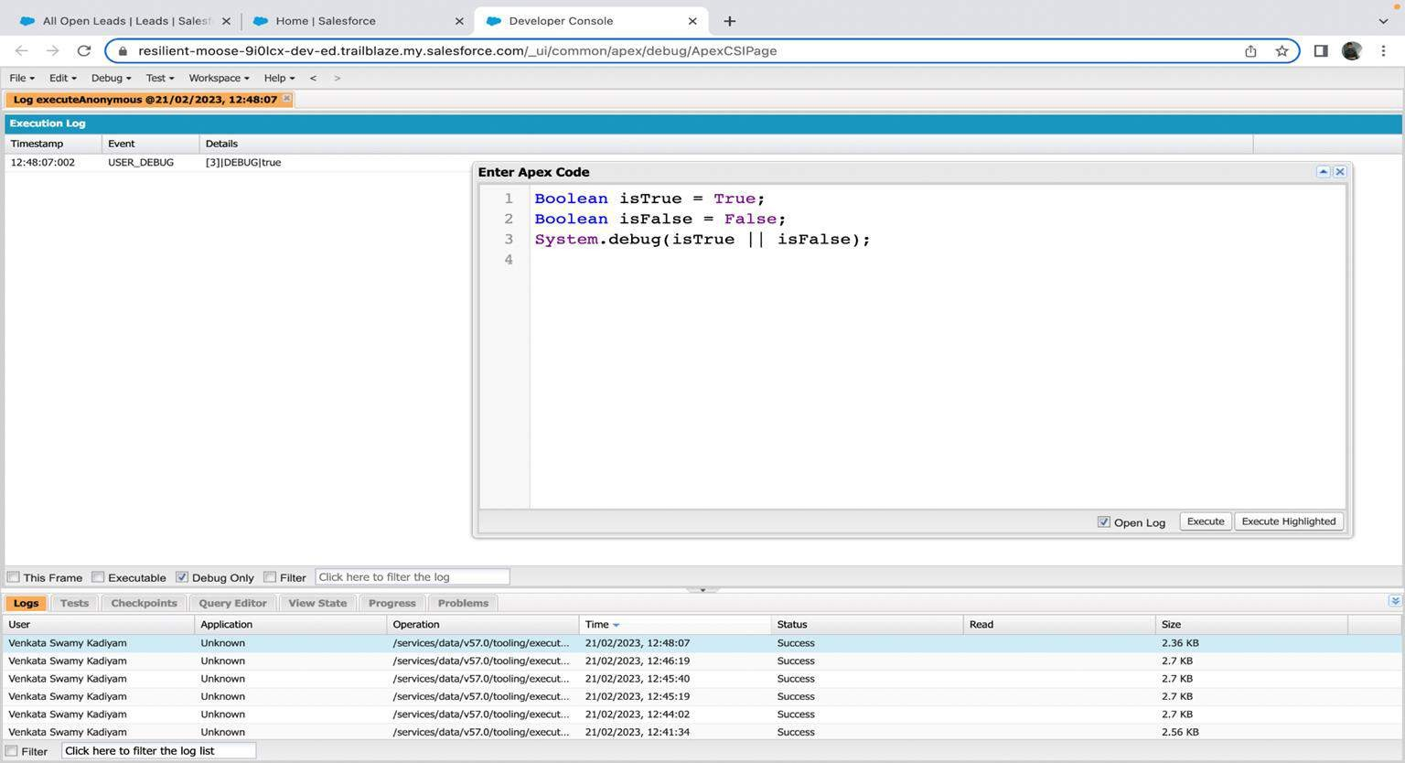
EXERCISE 4:
ANSWER THE FOLLOWING IN TRUE OR FALSE: BOOLEAN ISFALSE = FALSE; BOOLEAN ISTRUE = TRUE;

Slide 37
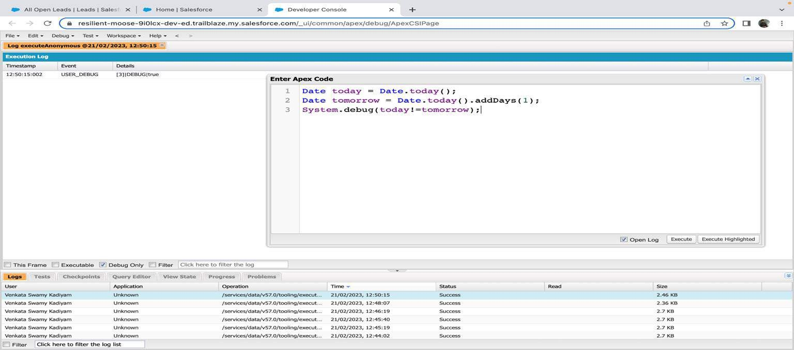
EXERCISE 5:
ANSWER THE FOLLOWING IN TRUE OR FALSE: DATE TOMORROW = DATE.TODAY().ADDDAYS(1); DATE TODAY = DATE.TODAY();
TODAY != TOMORROW

Slide 38
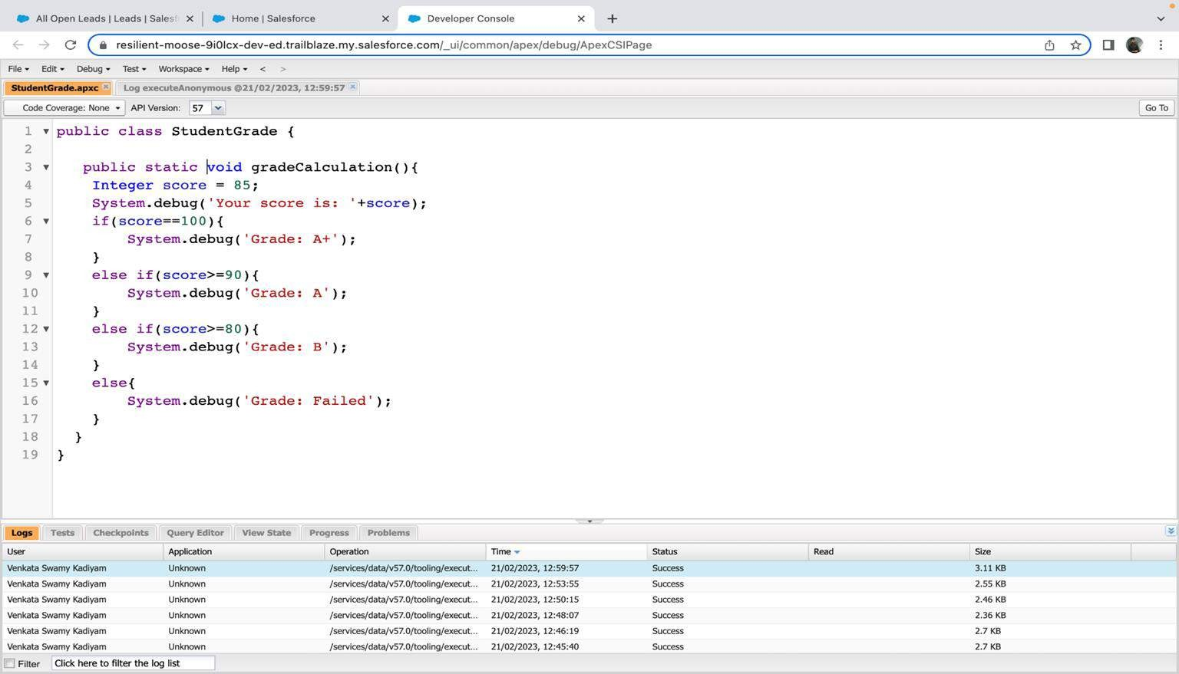
EXERCISE 6:
WRITE A PROGRAM AND EXECUTE TO DEMO THE USE OF “IF..ELSE IF...ELSE”

Slide 39
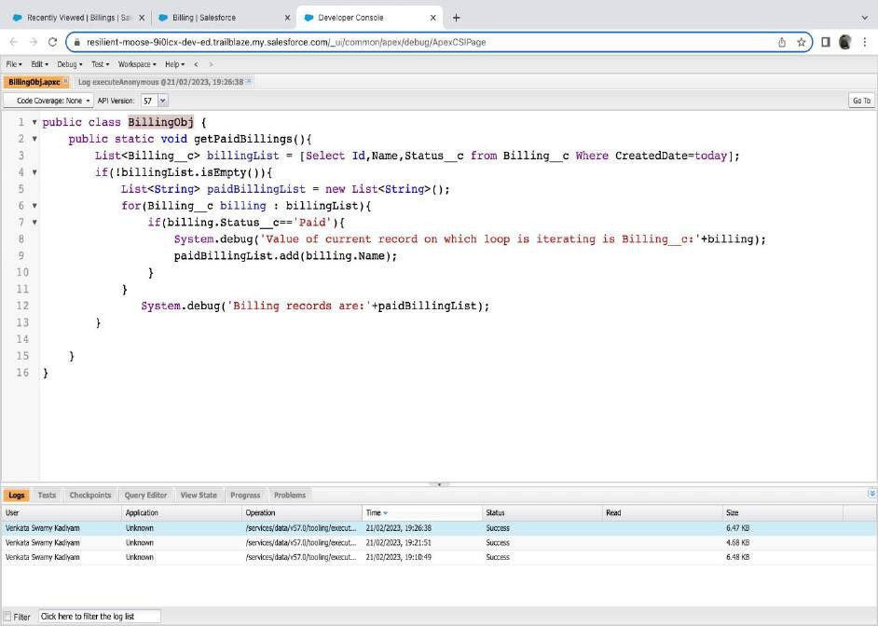
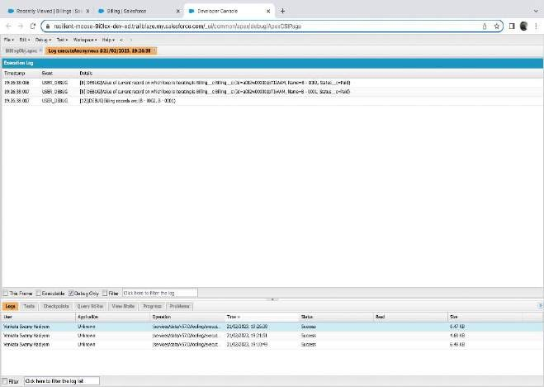
EXERCISE 7:
WRITE A PROGRAM TO EXECUTE AND DEMO THE USE OF “APEX – FOR
LOOP”

Slide 40
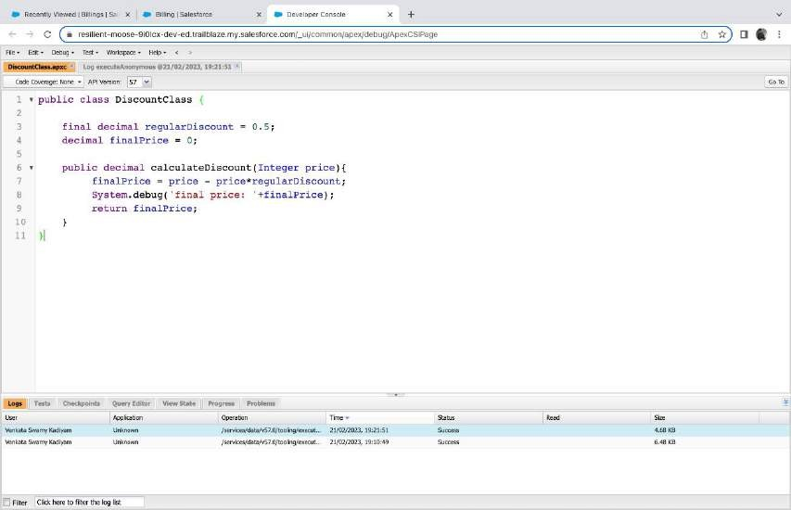
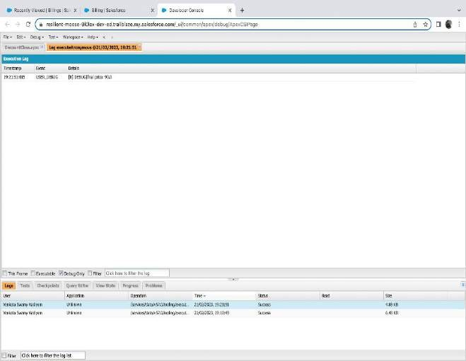
EXERCISE 8:
WRITE A CLASS TO DEMO THE USE OF CONSTANTS IN APEX:

Slide 41
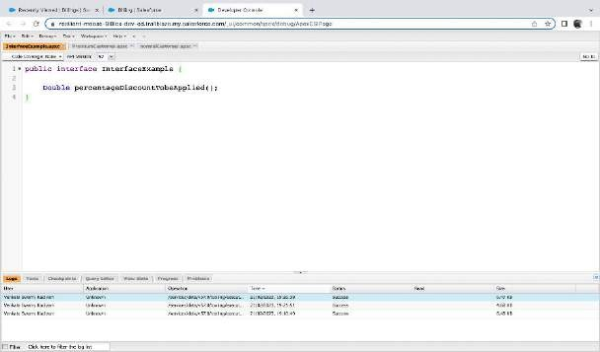
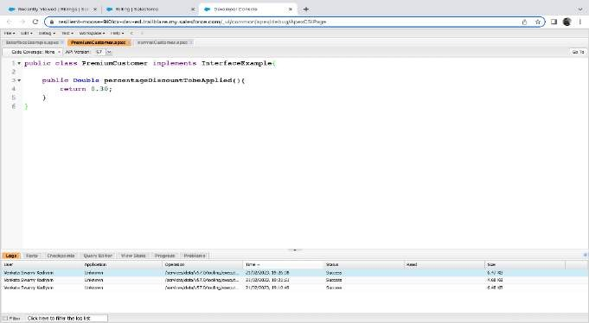
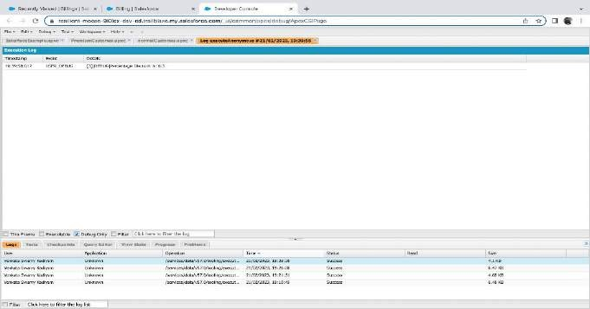
EXERCISE 9:
WRITE A CLASS TO DEMO THE USE OF INTERFACE IN APEX:

Slide 42
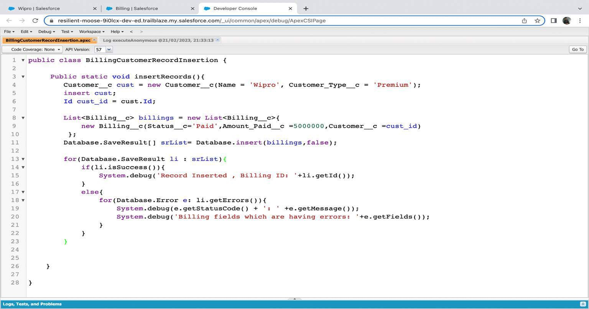
EXERCISE 10:
DEMO ON DML INSERT OPERATION USING DATABASE METHODS
1.INSERT A CUSTOMER RECORD FIRST USING SIMPLE DML STATEMENT

Slide 43
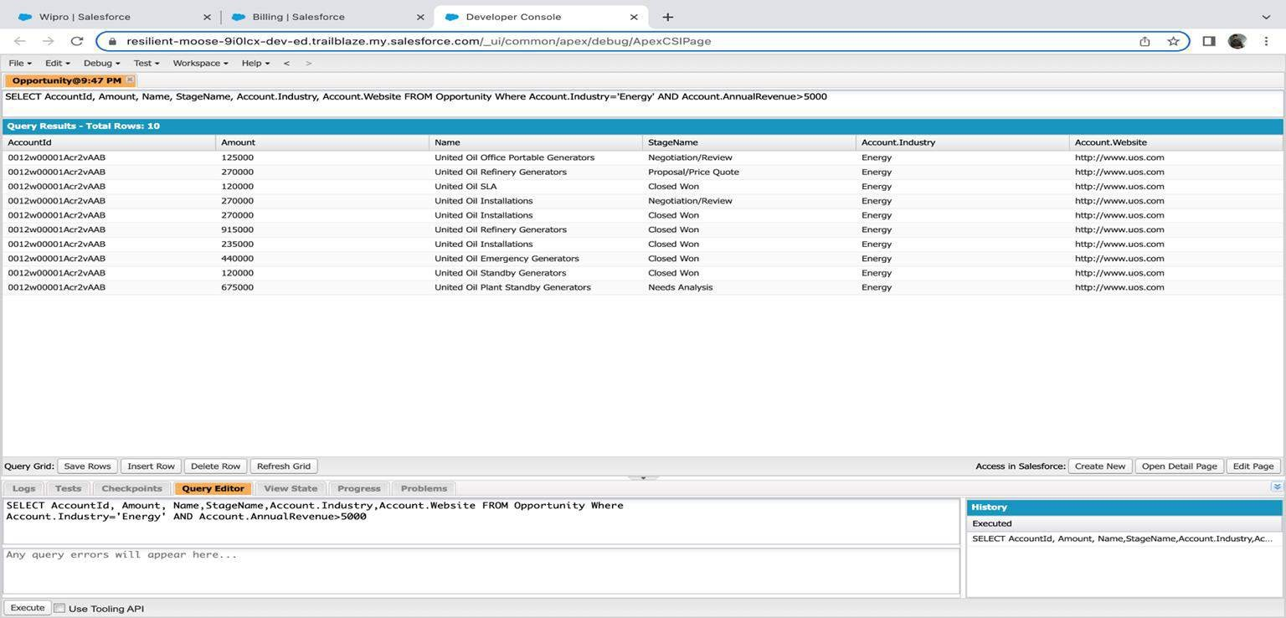
Exercise 11:
Write and execute SOQL queries from Developer Console
Display ID, Amount, Stage, Account Name, Account Industry, Account Website From Opportunity
AND “Account Annual Revenue > 5000”
Add a Where Clause “Account Industry = Energy”

Slide 44
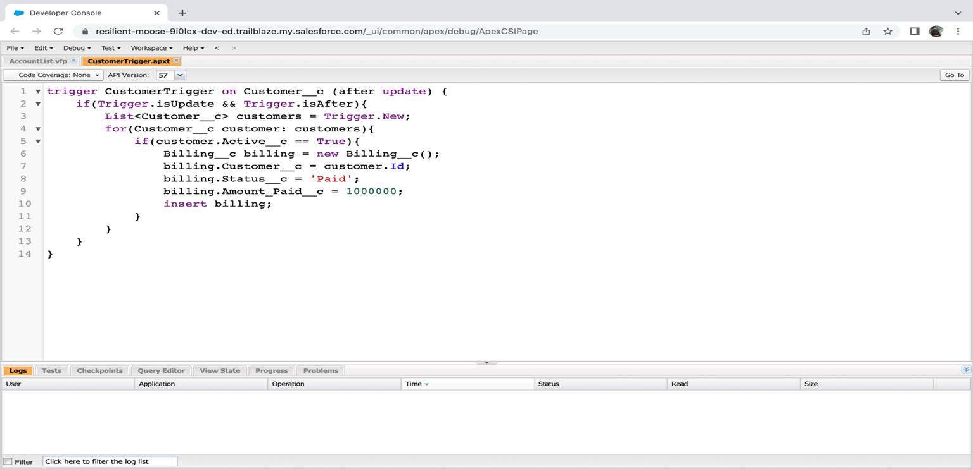
EXERCISE 12:
WRITE AN APEX TRIGGER, NAME = CUSTOMERTRIGGER. CREATE A BILLING RECORD WHEN ON CUSTOMER OBJECT THE 'STATUS' FIELD CHANGES TO ACTIVE FROM INACTIVE. BILLING “STATUS” MUST BE: PAID, AMOUNT PAID = 1000000
PERFORM THE DML ON A LIST.

Slide 45
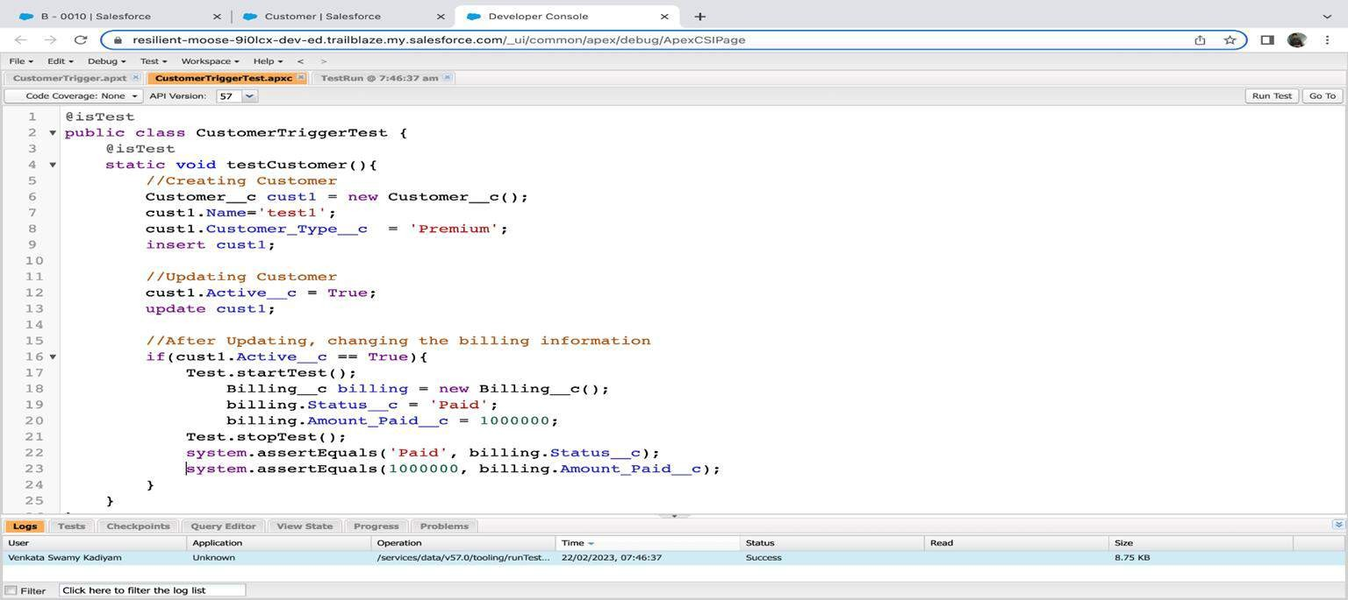
EXERCISE 13:
WRITE A TEST CLASS FOR CUSTOMERTRIGGER.
CREATE THE DATA FOR THE CUSTOMER CUSTOM OBJECT USE TEST.STARTTEST() & TEST.STOPTEST().
USE ASSERT STATEMENT TO VALIDATE THE OUTPUT,
TEST CLASS MUST HAVE FULL CODE COVERAGE.

Slide 46


Exercise 14
ApexTrigger,Name=DisqualifyTestLeads
Exercise 15
Write a Test Class for DisqualifyTestLeads.

Slide 47


EXERCISE 16:
CREATE A VISUALFORCE PAGE WHICH DISPLAYS OPPORTUNITY FIELDS AS OUTPUT FIELDS.

Slide 48


EXERCISE 17:
CREATE A VISUALFORCE PAGE WHICH SHOWS A LIST OF ACCOUNTS LINKED TO THEIR RECORD PAGES

Slide 49



EXERCISE 18:
CREATE A VISUALFORCE PAGE THAT USES A CUSTOM CONTROLLER TO DISPLAY A LIST OF CASES WITH THE STATUS OF 'NEW'. THE PAGE MUST BE NAMED NEWCASELIST.

Slide 50




